Slide 1
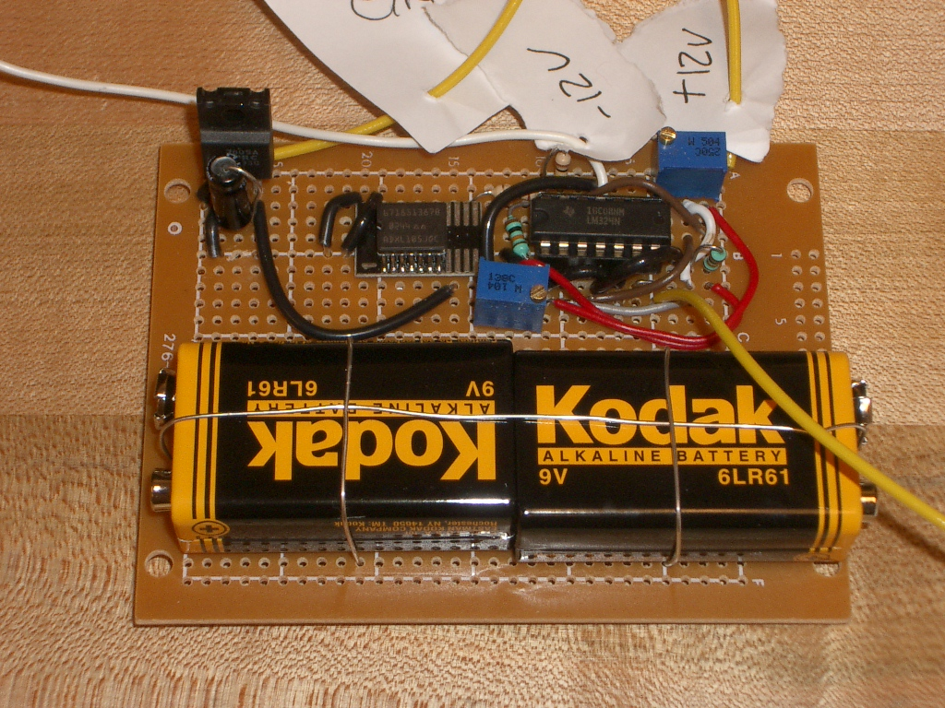
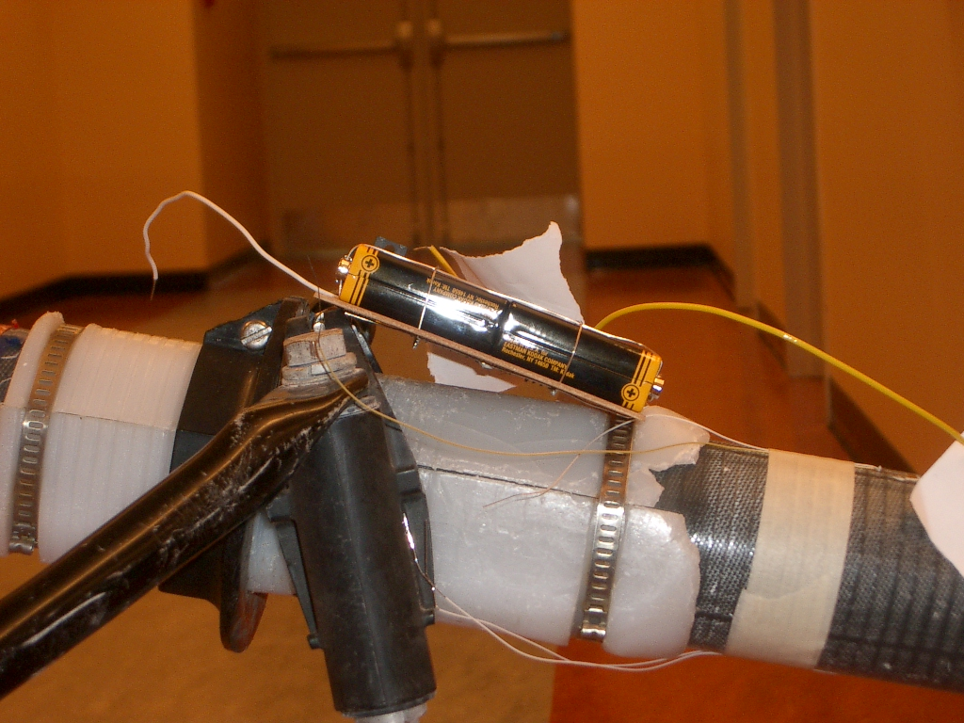
Trial 1 – Unsuccessful – Vertical Oar Sensor
Tilt Accelerometer Sensor
ENCL-7

